Slide 1

Owndays Housebrand

Slide 2
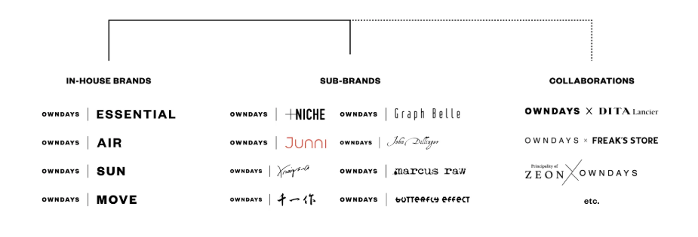
We are waiting for you with a wide variety of high-quality frames in more than 1,500 styles,
ranging from basic to functional, stylish and fashionable, always displayed in the shop.
Variety of the original private brands to match each price line and concept enables OWNDAYS to have strong competitiveness in the market.

Slide 3

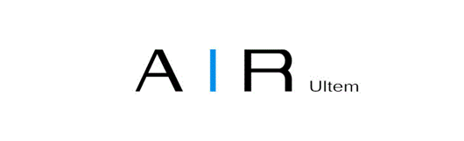
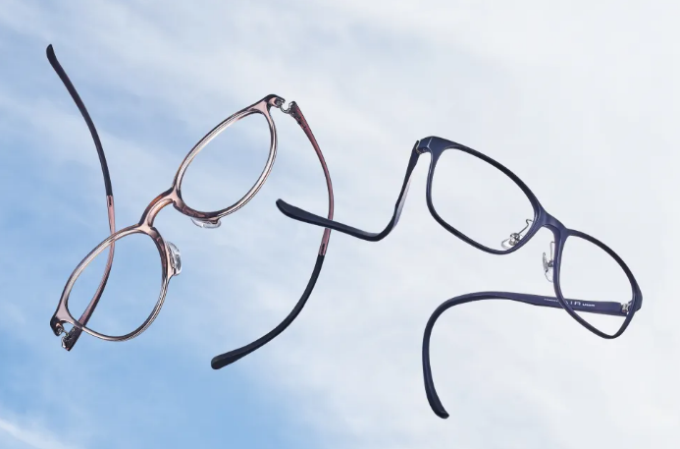
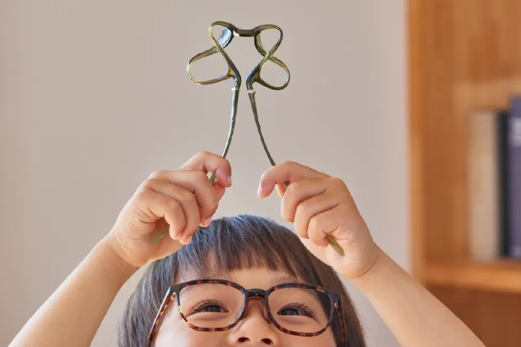
OWNDAYS | AIR
Incredibly Lightweight
The Durability You Can Rely On
Engineered with ultra-lightweight and highly durable materials to deliver a wearing comfort that feels like air, these metal frames offer an impeccable fit and can be worn comfortably for long hours.
Amazingly light frames at 9.4g. The frames have also passed the inspections of endurance and bridge distortion based on Japanese Industrial Standards (JIS B 7285:2008).
Resin (Ultem)
Recommended for : MEN・WOMEN
USP
  Feature: Ultralight frames made of Resin (Ultem).
  Benefit: Comfortable for all-day wear, flexible and durable.
  Target Group: Customers seeking lightweight, everyday glasses.

Slide 4

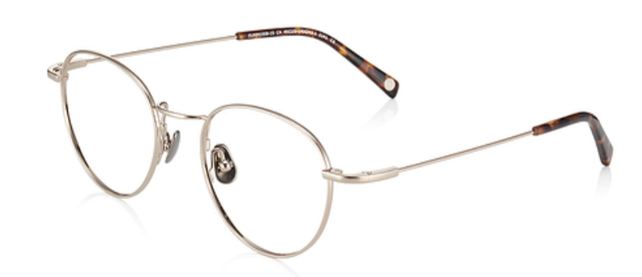
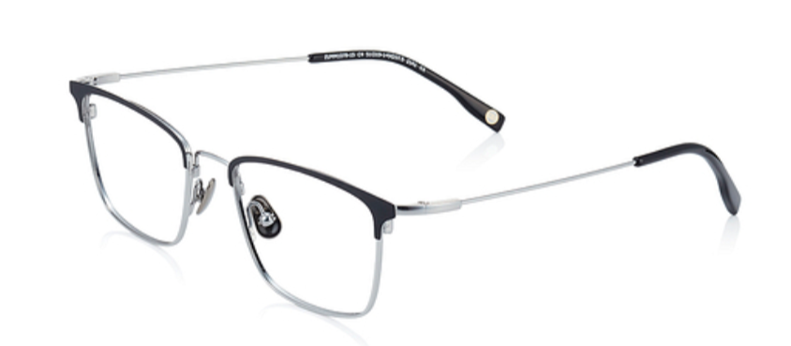

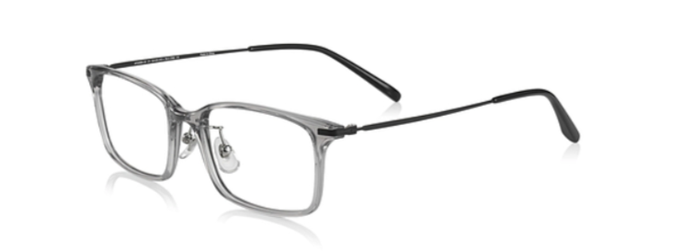
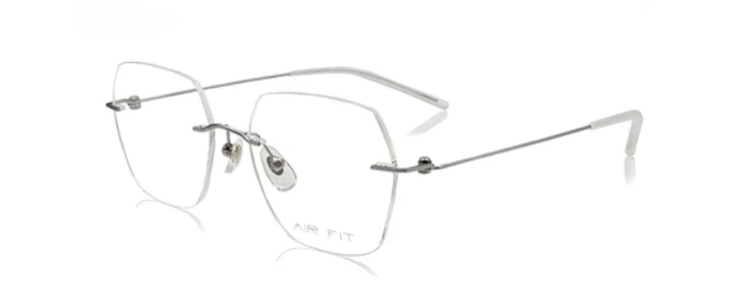
OWNDAYS | AIR
Lightweight, flexible and shape-retaining
Even though it’s metal
These Nitinol (NiTi) frames are made using the latest ion plating (IP) process. Nitinol is a shape memory alloy consisting of nickel and titanium. The material exhibits great elasticity and durability. It is able to retain its shape despite extensive bending. Ion plating is applied on the frame surface to enhance durability and resistance to rust. This prevents the frame coating from peeling or scratching, offering long-lasting quality.
Beta titanium
Recommended for : MEN・WOMEN
USP
    Feature: Nitinol frames with ion plating for durability.
    Benefit: Shape memory material prevents deformation; rust-resistant coating.
    Target Group: Those needing durable, long-lasting metal frames.
A collection of metal frames made of β titanium, titanium and stainless steel. Leveraging on the intrinsic characteristics of these metals, we bring you frames that are lightweight, flexible and corrosion resistant. The minimalist design makes it an easy pairing for everyone at any time.
Titanium/Stainless Steel
Recommended for : MEN・WOMEN
USP
  Feature: Lightweight, flexible, and corrosion-resistant metal frames.
  Benefit: Durable, comfortable, and suits any style.
  Target Group: Those seeking minimalist, long-lasting eyewear.

Slide 5

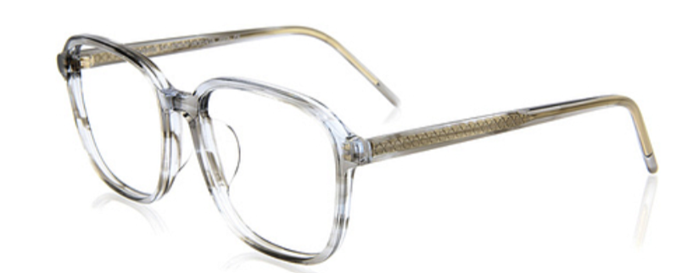
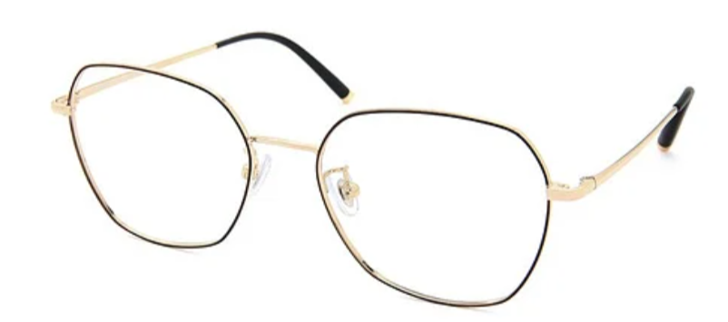

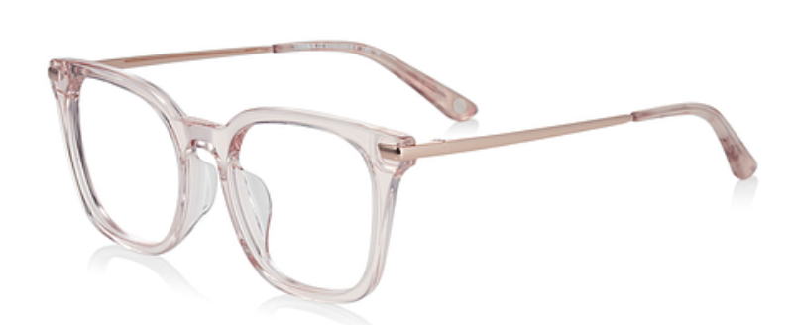
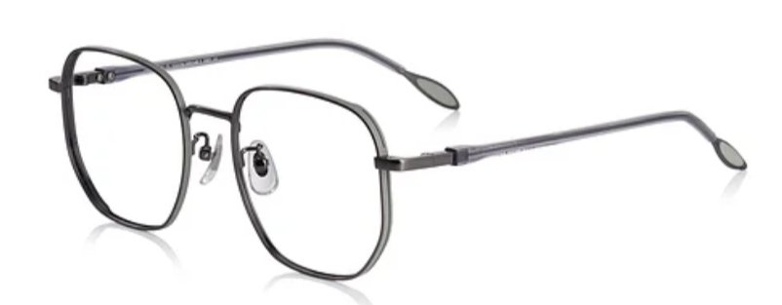
  Ride The Latest Wave
  For A Standout Style
  A collection for those who appreciate unique design elements and superior quality, featuring frames that make a subtle yet memorable statement.
  Acetate/Stainless Steel
  Recommended for : MEN・WOMEN
  USP
    Feature: Avant-garde design with unique materials.
    Benefit: Bold, stylish, and stands out from the crowd.
    Target Group: Trendsetters seeking distinctive eyewear.
  A collection that draws on the notion of enjoying the present, offering options that are on-trend and with elements of both elegance and edge. Designed for the sassy, buoyant sweethearts who enjoy a blend of street-style edge and delicate appeal, while basking in the pursuit of finesse and maturity as they transform into refined young ladies.
  Acetate/Stainless Steel
  Recommended for : MEN・WOMEN
  USP
    Feature: Fashion-forward designs with elegance and edge.
    Benefit: Trendy, stylish frames for unique expression.
    Target Group: Fashion-conscious individuals, young women.

Slide 6

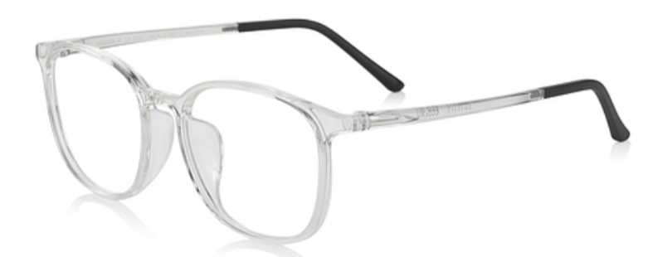
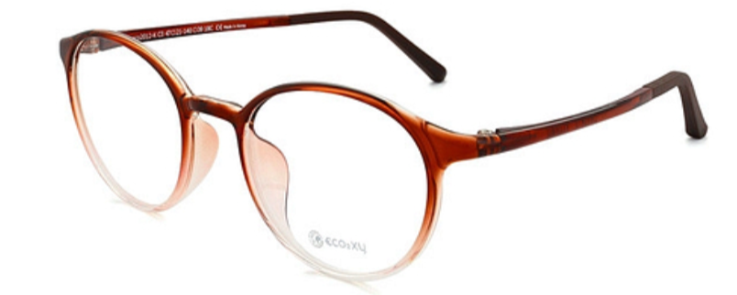

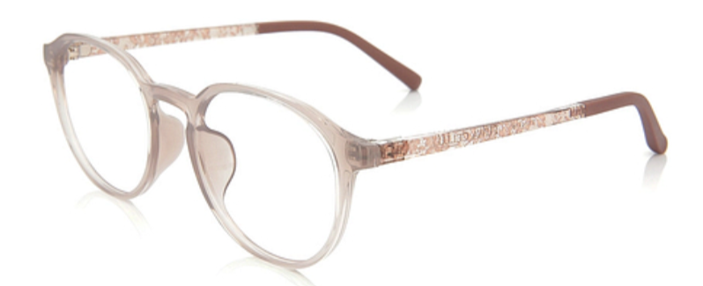
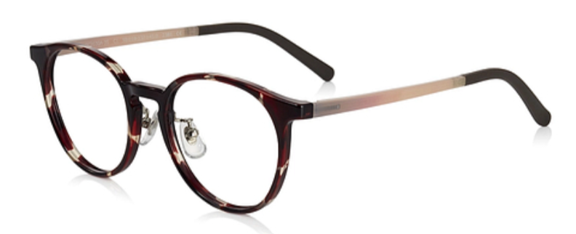
OWNDAYS | ESSENTIAL
  We are committed to both environment sustainability and your well-being. In the process of making our glasses, we employ production methods that minimize CO2 emission. Our frames are also designed such that your skin would not get in contact with any metal parts, making them safe even for people with allergies to metals. The resin ECO2XY (ekok-si) frames are not only lightweight and flexible, expect a full lineup of fun colors too!
  Unisex
  Polyamine resin / G850
  USP
    Feature: Eco-friendly, hypoallergenic frames.
    Benefit: Safe for sensitive skin, reduces CO2 emissions.
    Target Group: Eco-conscious consumers, allergy-prone users.
  Soft as a feather, light as the air. FUWA CELLU frames are light and flexible, also tough against shocks. Simple and clear, colorful and feminine designs. "TR-90", the new material of 21st century, is a safe material which is developed for medical equipment.
  Female
  TR-90
  USP
    Feature: Lightweight, flexible TR-90 material.
    Benefit: Shock-resistant, colorful, and comfortable.
    Target Group: Women who want stylish, lightweight frames.

Slide 7

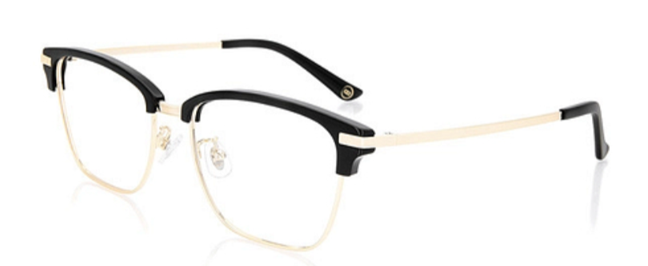
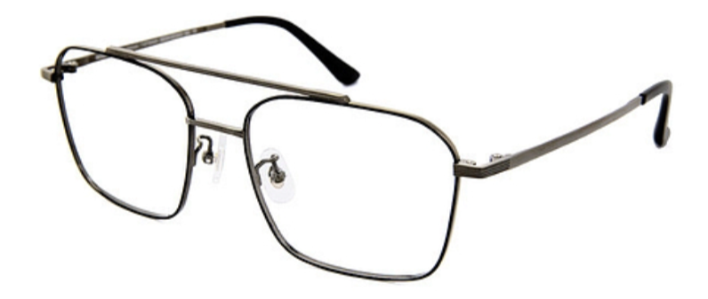
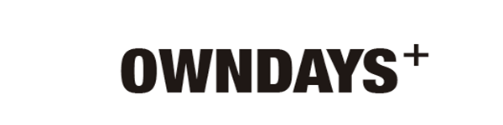
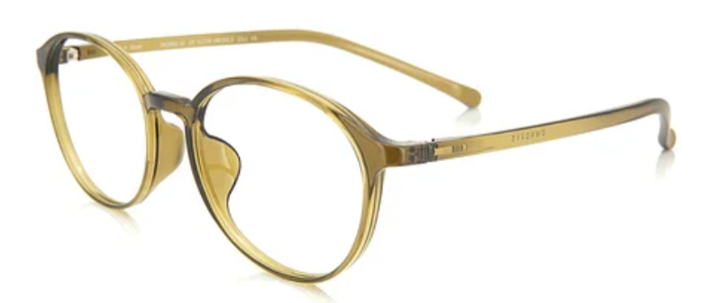
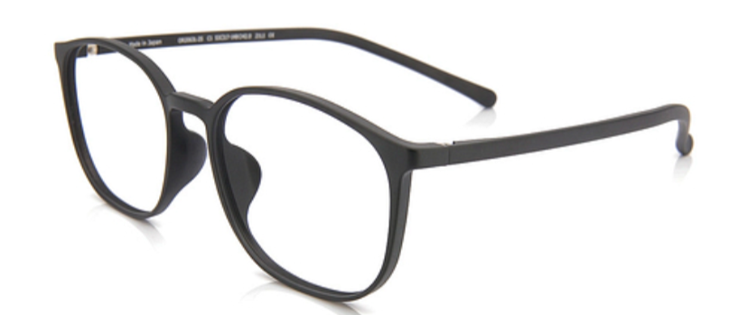
OWNDAYS | ESSENTIAL
  A brand for sophisticated men with gentle atmosphere. This name "Based" represents men who are living based on their experience and has depth in life. A life with stability and profundity should be handed down to the next generation; that we think glasses should be like so.
  Male
  Titanium / stainless steel
  USP
    Feature: Classic, smart men’s eyewear.
    Benefit: Timeless design with durable materials.
    Target Group: Professional men seeking refined frames.
  OWNDAYS aspires to present eyewear that is modest and a true reflection of the wearer’s personality. Without deliberate pursuit of design, A subtle, modest approach that brings the true spirit of Japanese craftsmanship to life. Where minimalist aesthetic and sublime quality meet efficient pricing, that’s OWNDAYS+.
  Unisex
  TR90
  USP
    Feature: Minimalist, high-quality eyewear at affordable prices.
    Benefit: Simple, refined designs with superior craftsmanship.
    Target Group: Budget-conscious buyers.

Slide 8

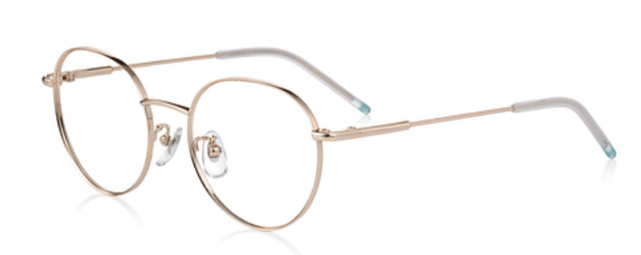
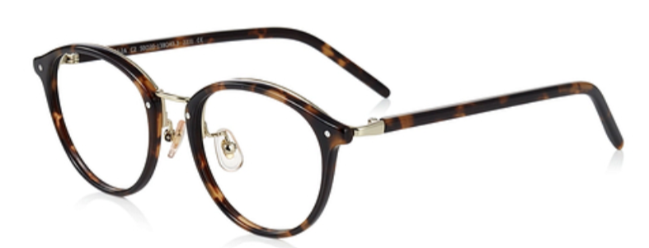

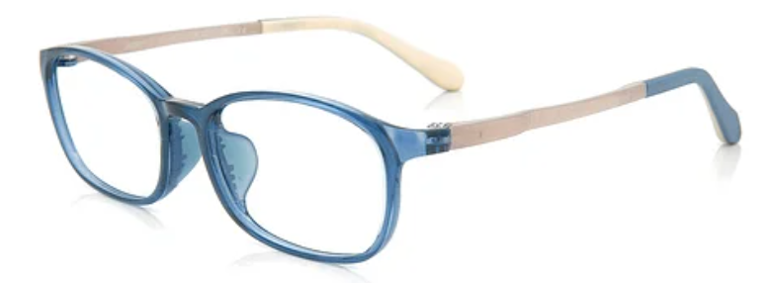
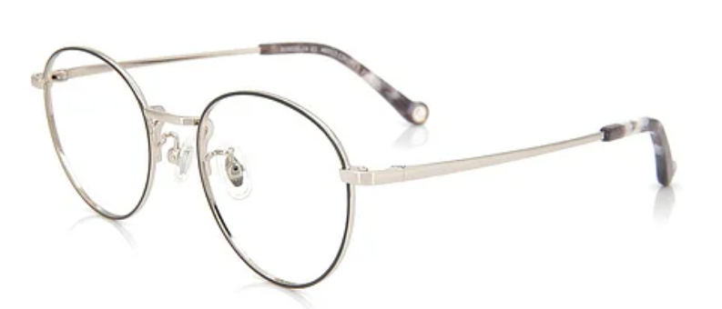
  The Definition Of Me
  Composed And Elegant
  A collection that embodies the beauty of minimalism, featuring frames in simple yet sophisticated designs that complement any style.
  Stainless Steel /Titanium /Acetate
  Recommended for : WOMEN
  USP
    Feature: Feminine frames with modern and classic designs.
    Benefit: Stylish and elegant
    Target Group: Stylist and Classy adult women.
Levelling Up To The Adults In Style And Durability
A delightful frame collection designed specifically for children, drawing on the concept of “fashion is not just for the adults”. Pairing stylish designs with an emphasis on comfort and impeccable fitting, they are perfect for everyday use by the little ones.
  Stainless Steel / Acetate / TR90
  Recommended for : Unisex (kids)
  USP
    Feature: Stylish, colorful frames for kids.
    Benefit: Fun, durable designs with a comfortable fit.
    Target Group: Kids and adults with small faces.

Slide 9

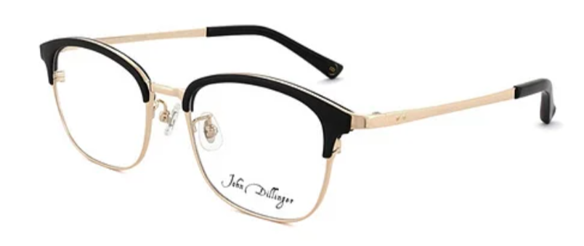
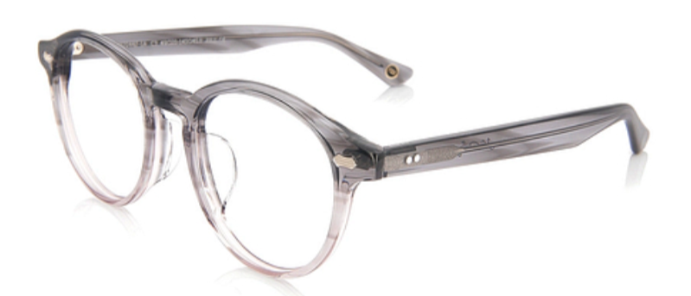

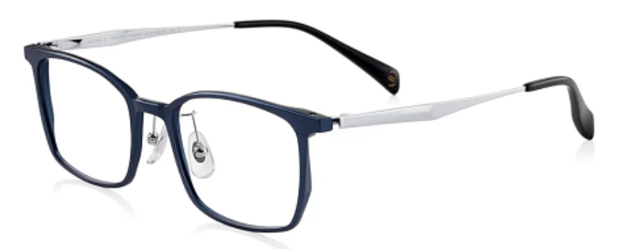
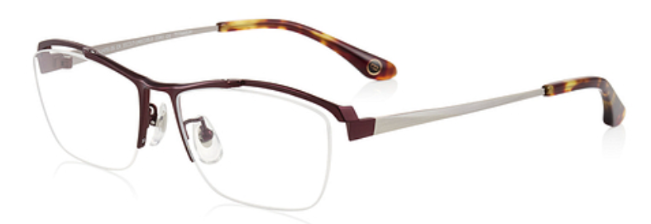
Vintage Reinterpreted
This frame collection depicts a contemporary revival of retro styles, meticulously weaving intricate details such as colors, patterns and metallic accents with evolving perspectives.
  Alloy / Stainless Steel /Titanium / Acetate
  Recommended for : MEN
  USP
    Benefit: Unique, vintage aesthetic with premium materials.
    Target Group: Retro-style
  Creating Fluid Strokes
  Always Radiating In Elegance
  A collection that combines traditional Japanese aesthetics with modern design sensibilities, featuring frames of exceptional quality.
  Titanium/ stainless steel
  Recommended for : MEN・WOMEN
  USP
    Feature: Elegant metallic frames with a shiny finish.
    Benefit: Classy, versatile eyewear for all occasions.
    Target Group: Men/Women seeking understated luxury.

Slide 10

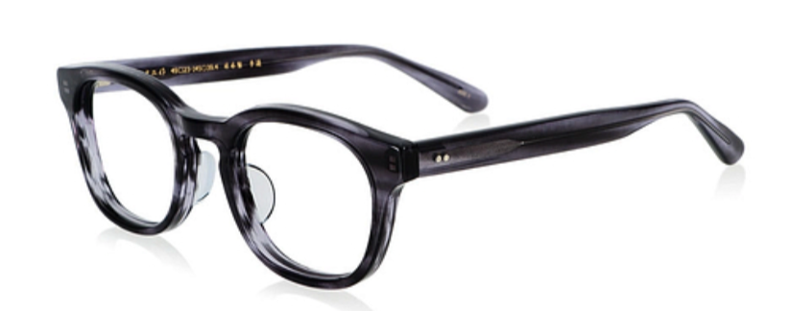
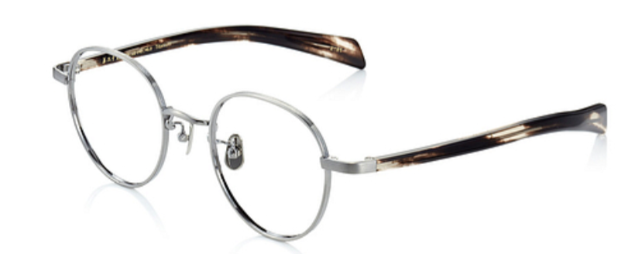
  Japanese Craftsmanship
  The Epitome Of Sublime Beauty
  Senichi - A premium collection that showcases the finest Japanese craftsmanship, featuring frames made with exceptional attention to detail.
  Celluloid/Titanium
  Recommended for : MEN・WOMEN
  USP
    Feature: Handcrafted celluloid and beta-titanium frames.
    Benefit: Vintage charm with strong, flexible materials.
    Target Group: Collectors and high-end buyers.

Slide 11

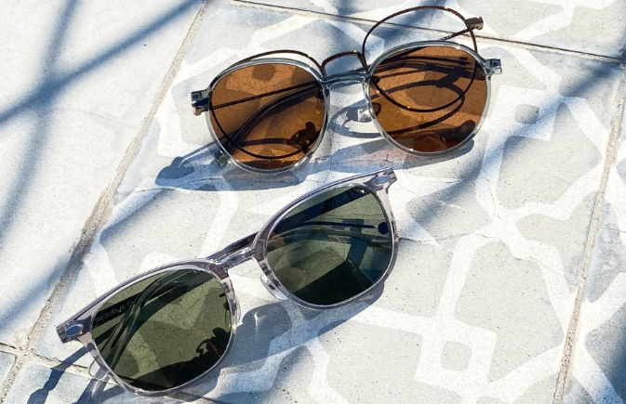
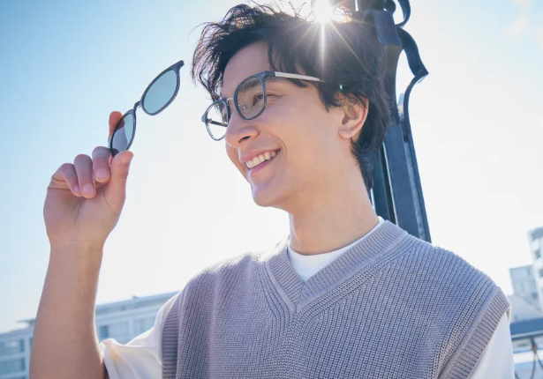

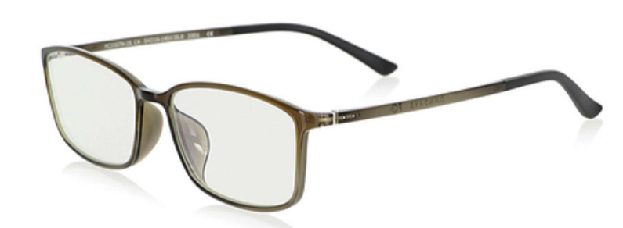
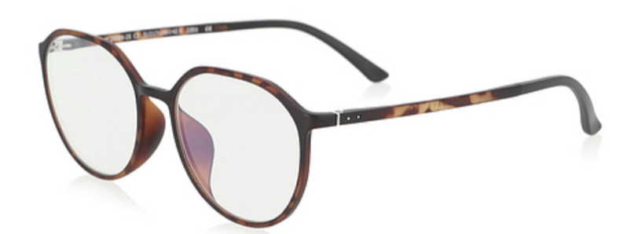
Heart's Leaping
Under The Sun
Where fashion meets function. Coming in an array of vibrant designs, these sunglasses not only reduce glare and protect your eyes from UV rays but also enable you to see the world more vividly. With SUN by your side, every moment becomes extra special.
Stainless Steel / Ultem / TR90
Recommended for : MEN・WOMEN
USP
  Feature: Magnetic clip-on lenses.
  Benefit: Instantly switch between lens types.
  Target Group: Users who need prescription and sun protection.
  The Smart Choice
  For Digital-Age Consumers
  A collection designed for the digital age, featuring frames with blue light protection for comfortable screen time.
  Resin (Ultem)
  Recommended for : MEN・WOMEN
  USP
    Feature: Blue light filtering up to 25%
    Benefit: Reduces eye strain from screens.
    Target Group: Office workers, gamers, students.

Slide 12

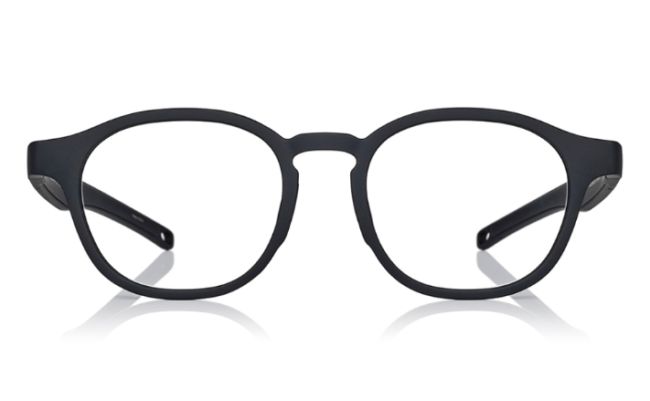
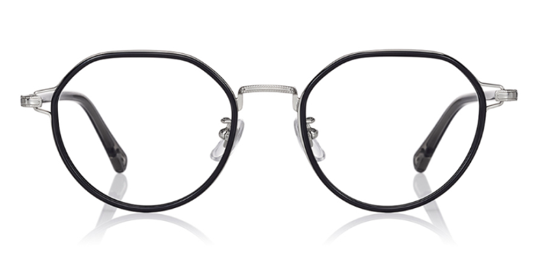

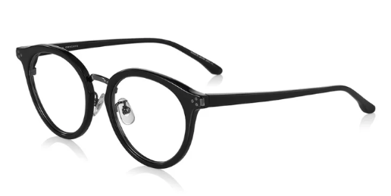
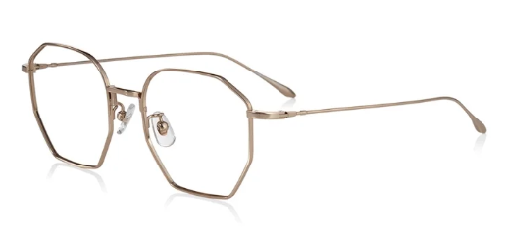
OWNDAYS × COLLABORATION
Joining forces with FREAK' S STORE, a Japanese select store with an American spirit at heart, we bring to you a capsule collection built on the concept of "items that bring abundance and excitement to your lifestyle". Find eyewear in trendsetting styles from this season that you will have fun incorporating into different looks.
Acetate/ stainless steel
Recommended for : MEN・WOMEN
USP
  Feature: Trendsetting eyewear collection.
  Benefit: Adds excitement and versatility to fashion.
  Target Group: Young, fashion-forward individuals.
An eyewear project designed by Shingo Aiba, a Japanese designer from a global fashion brand, using the sensibilities he cultivated in Paris "Made In JAPAN" has been producing eyeglasses for over 50 years in Sabae City, Fukui Prefecture, where Japanese eyeglasses are produced, combining the skills of craftsmen and advanced technology to create the best comfort and sophisticated design. It's a collection.
Acetate/ titanium
Recommended for : MEN・WOMEN
USP
  Feature: Designer frames with modern-retro influence.
  Benefit: Unique styles blending classic details with modern materials.
  Target Group: Trendsetters and design

Slide 13

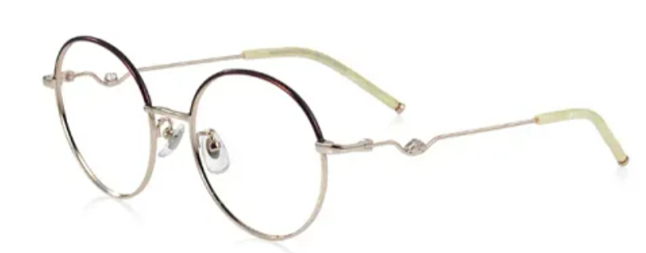
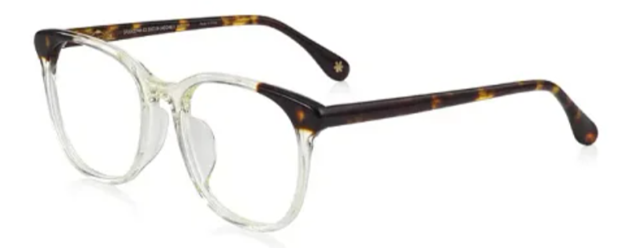

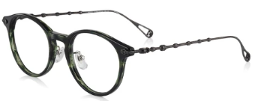
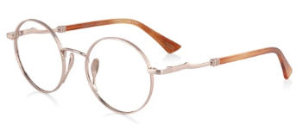
Presenting the spectacle frame collaboration with POMPOMPURIN. It’s cuteness overload with these spectacle frames featuring Pompompurin, the boy golden retriever with his trademark brown beret. Whether you’re out and about or relaxing at home, pick your favourable pair and keep Pompompurin by your side at all time!
Stainless steel / Acetate
Recommended for : MEN・WOMEN
USP
  Feature: Cute frames featuring Pompompurin.
  Benefit: Fun, playful eyewear for fans of the character.
  Target Group: Sanrio lovers and those who enjoy cute designs.
A special collaboration featuring frames inspired by the magical world of Harry Potter, perfect for fans of the beloved series.
Acetate/ Stainless Steel
Recommended for : MEN・WOMEN
USP
  Feature: Frames inspired by iconic symbols from the films.
  Benefit: A tribute for Harry Potter fans.
  Target Group: Fans of the franchise, collectors.

Slide 14

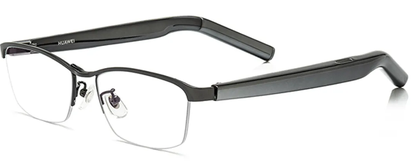
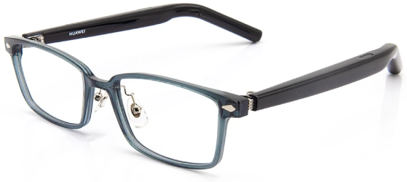
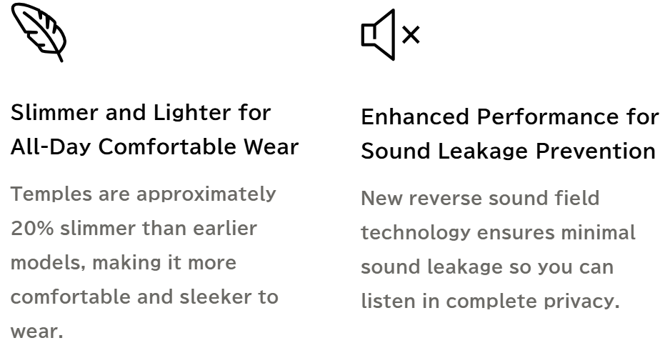
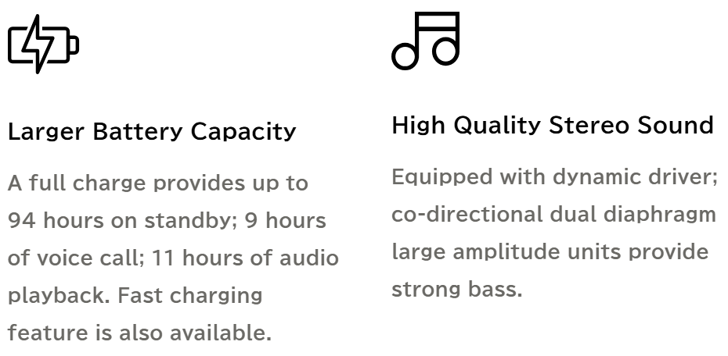
Introducing the Titanium Edition of the OWNDAYS × HUAWEI Eyewear 2 Smart Audio Glasses. With this addition, the collection now features six models, each available in two color variations.
Designed for an enhanced auditory and visual experience, these smart audio glasses offer improved sound quality while weighing lighter than previous generation.
TR90/Titanium
Recommended for : MEN・WOMEN
USP
  Feature: Glasses with built-in audio functionality.
  Benefit: Improved sound quality with lightweight design.
  Target Group: Tech-savvy users, music lovers.

Slide 15


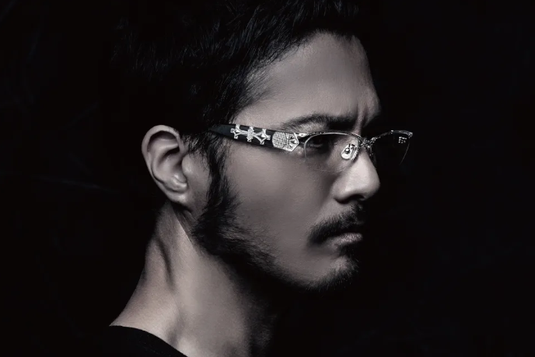

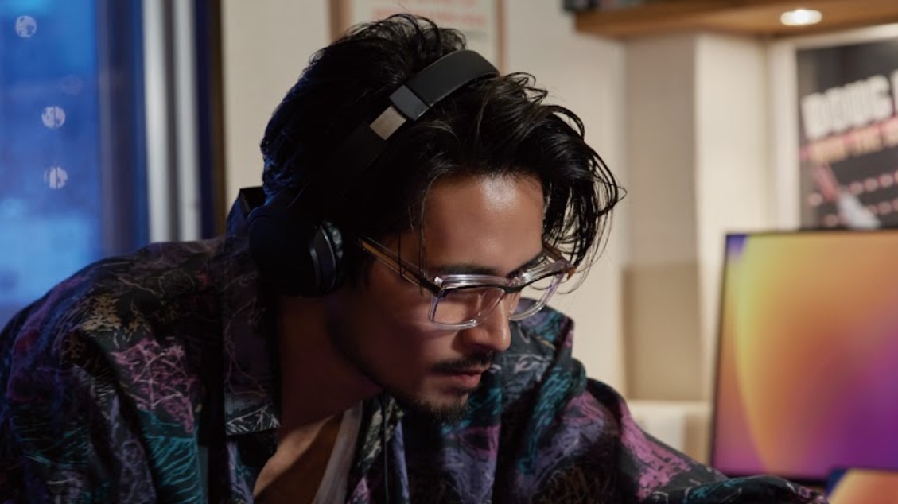
EXCLUSIVELY SOLD AT OWNDAYS MBS /TAKA
A collaboration between OWNDAYS and former PRIDE world champion, Takanori Gomi. This is a collection created for people who challenge the conventions and defy stereotypes in the journey of self-discovery. Combining delicate silver decorative details with solid metal forms, the frames exude both luxury and a strong sense of individual style.
Alloy / Acetate
Recommended for : MEN
USP
  Feature: Luxury frames with silver details.
  Benefit: Strong, stylish eyewear with a premium feel.
  Target Group: Bold, confident individuals.
Unleash Your Individuality
Through New Challenges
A collection that celebrates feminine beauty and grace, featuring frames with delicate details and sophisticated designs.
Acetate
Recommended for : WOMEN
USP
  Feature: Bold, artistic frame designs.
  Benefit: Encourages self-expression and uniqueness.
  Target Group: Those who love statement eyewear.

Slide 16

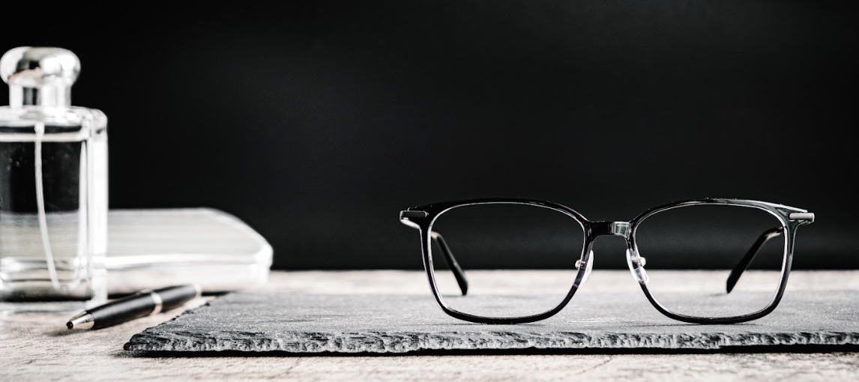

Featuring the finest eyewear from Japan. Curated for OWNDAYS Premium Concept Store. Handcrafted by Japanese eyewear artisans detailed craftsmanship. High standards of workmanship by out trusted manufacturers. Classic design that will never go out of style.
Titanium / Resin / Aluminum
Recommended for : MEN・WOMEN
USP
  Feature: Handcrafted Japanese eyewear.
  Benefit: Classic, timeless designs with expert craftsmanship.
  Target Group: High-end buyers looking for exclusivity.
A collaborative collection with luxury eyewear brand DITA, featuring frames that combine premium materials with sophisticated design.
Stainless steel/ Acetate
Recommended for : MEN・WOMEN
USP
  Feature: High-end frames made with premium materials.
  Benefit: Luxury design for a classy look.
  Target Group: Luxury eyewear seekers.

